Slide 1
Digital Portfolio
STUDENNAME : Pradeep. S
REGISTER NO AND NMID: 222410975
DEPARTMENT: B.sc(COMPUTER SCIENCE)
COLLEGE: SRI BALAJI ARTS & SCIENCE COLLEGE/MADRASUNIVERSITY

Slide 2
PROJECT TITLE
Showcasing a skill through a responsible personal porfolia website

Slide 3


AGENDA
1.Problem Statement
2.Project Overview
3.End Users
4. Tools and Technologies
5. Portfolio design and Layout
6. Features and Functionality
7.Results and Screenshots
8.Conclusion
9.Github Link
3/21/2024 Annual Review

Slide 4

PROBLEM STATEMENT
In today's competitive environment, individuals struggle to effectively
Showcase their skills projects,and achievements in a professional way.
Traditional resumes ans static profiles fail to capture creativity,
Personality and technical ability.
Lack of an online presence reduces opportunities for networking,
Internships,and career growth.
There is a need for a responsible,visually appealing,and accessible personal portfolio website that highlights one's skills,project and
achievements across all devices.

Slide 5

PROJECT OVERVIEW
The project focuses on developing a responsive personal portfolio website to showcase an individual's skills, projects, and achievements in a professional and creative way.
The website will serve as a digital resume and portfolio, highlighting technical expertise, creativity, and personal branding.
It will be designed with a user-friendly interface and responsive layout to ensure compatibility across devices (desktop, tablet, and mobile
The portfolio will include key sections such as About Me, Skills, Projects Resume, and Contact Information.

Slide 6

WHO ARE THE END USERS?
Definition: End users are the final audience or customers who interact directly with the outcome of your project. Role: They are not necessarily the buyers or decision-makers, but the people who actually operate, experience, or benefit from what's delivered. Importance: Understanding end users ensures the project meets real needs, is user-friendly, and provides value.

Slide 7

TOOLS AND TECHNIQUES
Research tools and techniques (e.g., surveys, interviews, data analysis methods)
Project management tools and techniques (e.g., Agile, Gantt charts, Jira, Trello)
Teaching/learning tools and techniques (e.g., digital tools, active learning methods)
Problem-solving tools and techniques (e.g., brainstorming, root cause analysis, mind mapping)
Technical tools and techniques in a specific field (like software development, engineering, art, etc.)

Slide 8
POTFOLIO DESIGN AND LAYOUT
Clean Title Slide - Include your name, role, and a simple background for a professional look. About Me Section - Short intro with photo, education, and skills using icons or infographics. Skills Showcase - Display technical and soft skills with progress bars, charts, or visuals. Projects/Portfolio Grid - Highlight your best works with screenshots, tools used, and short descriptions. Contact/Thank You Slide - Provide your email, LinkedIn, GitHub, and a QR code for easy access.
8

Slide 9
FEATURES AND FUNCTIONALITY
Responsive Design - Works smoothly on desktop, tablet, and mobile devices. Interactive UI - Clean navigation with animations and hover effects. Project Showcase - Dedicated sections with images, descriptions, and live/demo links. About Me Section - Profile, skills, and background details. Contact Form Easy way for users to reach out via email/message. +

Slide 10
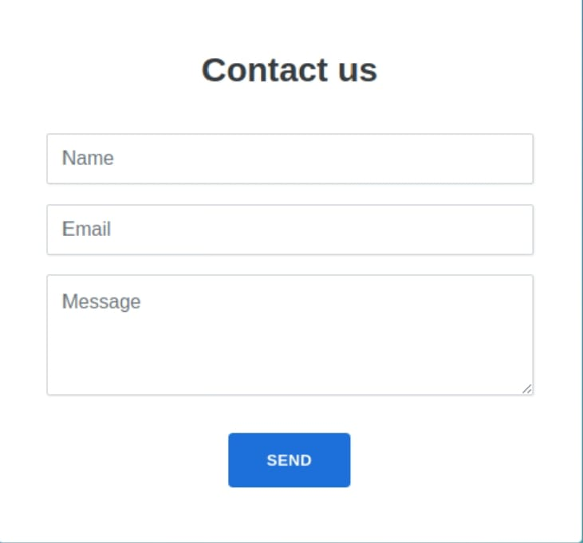

RESULTS AND SCREENSHOTS
3/21/2024 Annual Review
10

Slide 11
CONCLUSION
A responsive personal portfolio website was successfully developed. It provides a professional platform to showcase skills, projects, and achievements. The design ensures user-friendly navigation and works seamlessly across devices. This project enhances personal branding and can be used fo opportunities. + WPS AI Future improvements can include adding a blog section, dark mode, and animations.
11

